Slide 1
자율 지능 시스템 연구실
자율 지능 시스템 연구실 세미나
2024. 04.12
중앙대학교 기계공학과
자율지능시스템 연구실 석사과정생 김형빈

Slide 2
0
INDEX
자율 지능 시스템 연구실
INDEX
1
연구목표
2
지난 연구 요약
3
연구내용
4
향후 연구방향
5
문의사항

Slide 3
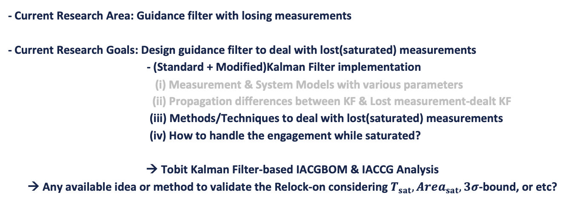
1
연구목표
자율 지능 시스템 연구실
- Current Research Area: Guidance filter with losing measurements
- Current Research Goals: Design guidance filter to deal with lost(saturated) measurements
- (Standard + Modified)Kalman Filter implementation
(i) Measurement & System Models with various parameters
(ii) Propagation differences between KF & Lost measurement-dealt KF
(iii) Methods/Techniques to deal with lost(saturated) measurements
(iv) How to handle the engagement while saturated?
→ Tobit Kalman Filter-based IACGBOM & IACCG Analysis
→ Any available idea or method to validate the Relock-on considering $T_{sat}, {Area}_{sat}, 3σ$-bound, or etc?

Slide 4
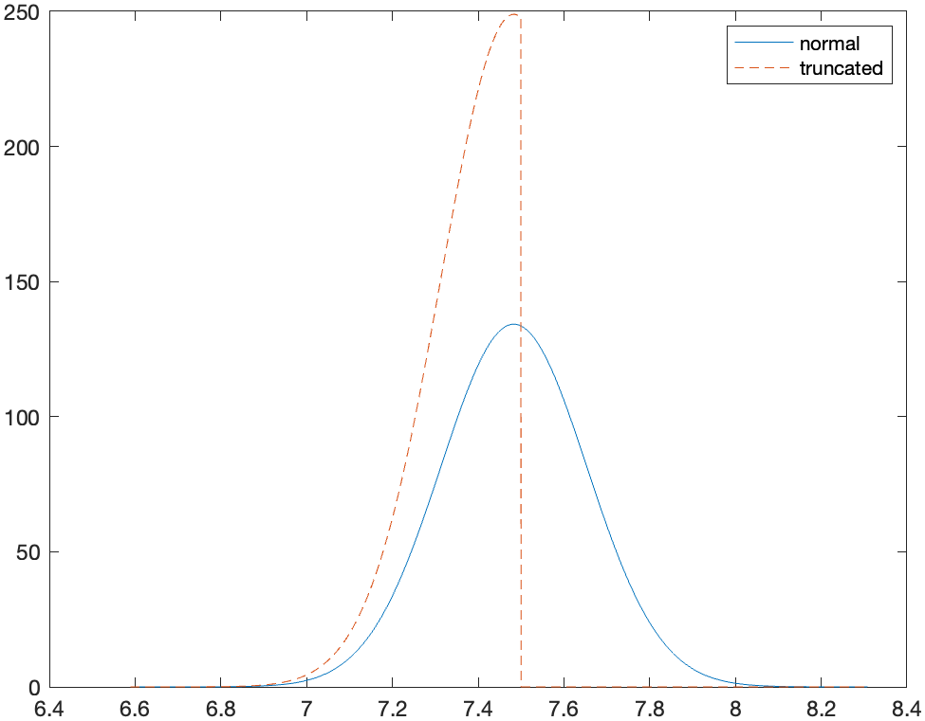
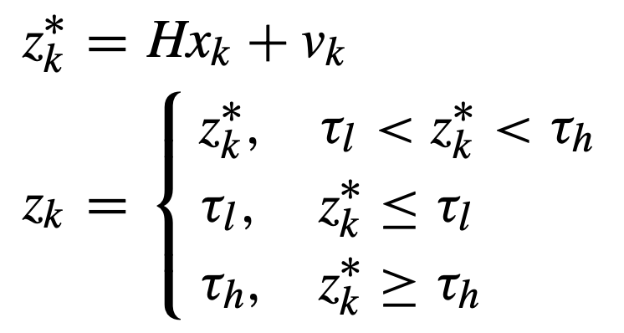


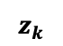
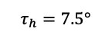
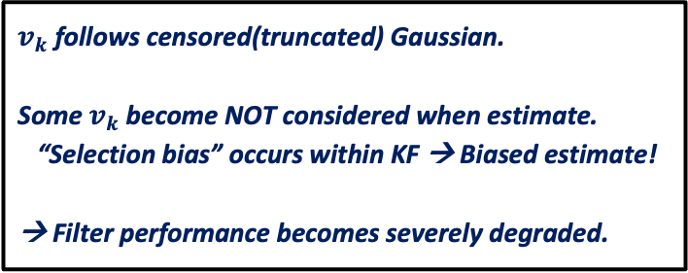
2
지난 연구 요약
자율 지능 시스템 연구실
Probability Density (PD)
$z_{k}^{∗}$ : Latent variable
: Unsaturated
: Lower saturated
: Higher saturated
$v_{k}$ follows censored(truncated) Gaussian.
Some $v_{k}$ become NOT considered when estimate.
“Selection bias” occurs within KF → Biased estimate!
→ Filter performance becomes severely degraded.
$$z_{k}$$
$$τ_{h}=7.5°$$
Fig. PDFs of measurement $z_{k}$: Normal & Truncated
Conditional distribution of the measurement.
→ “Truncated” Gaussian distribution

Slide 5
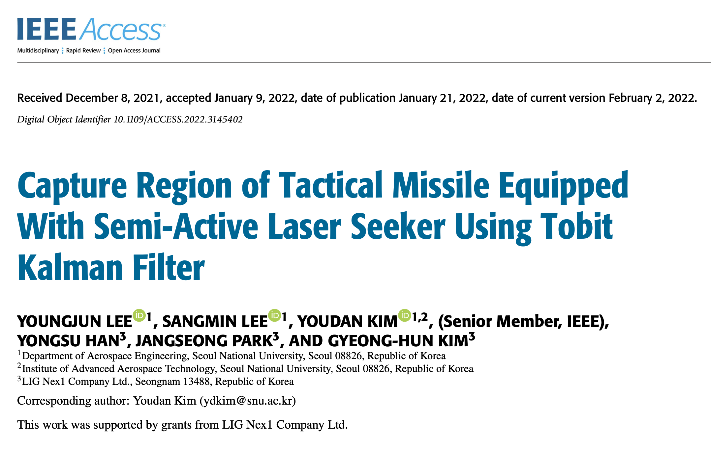
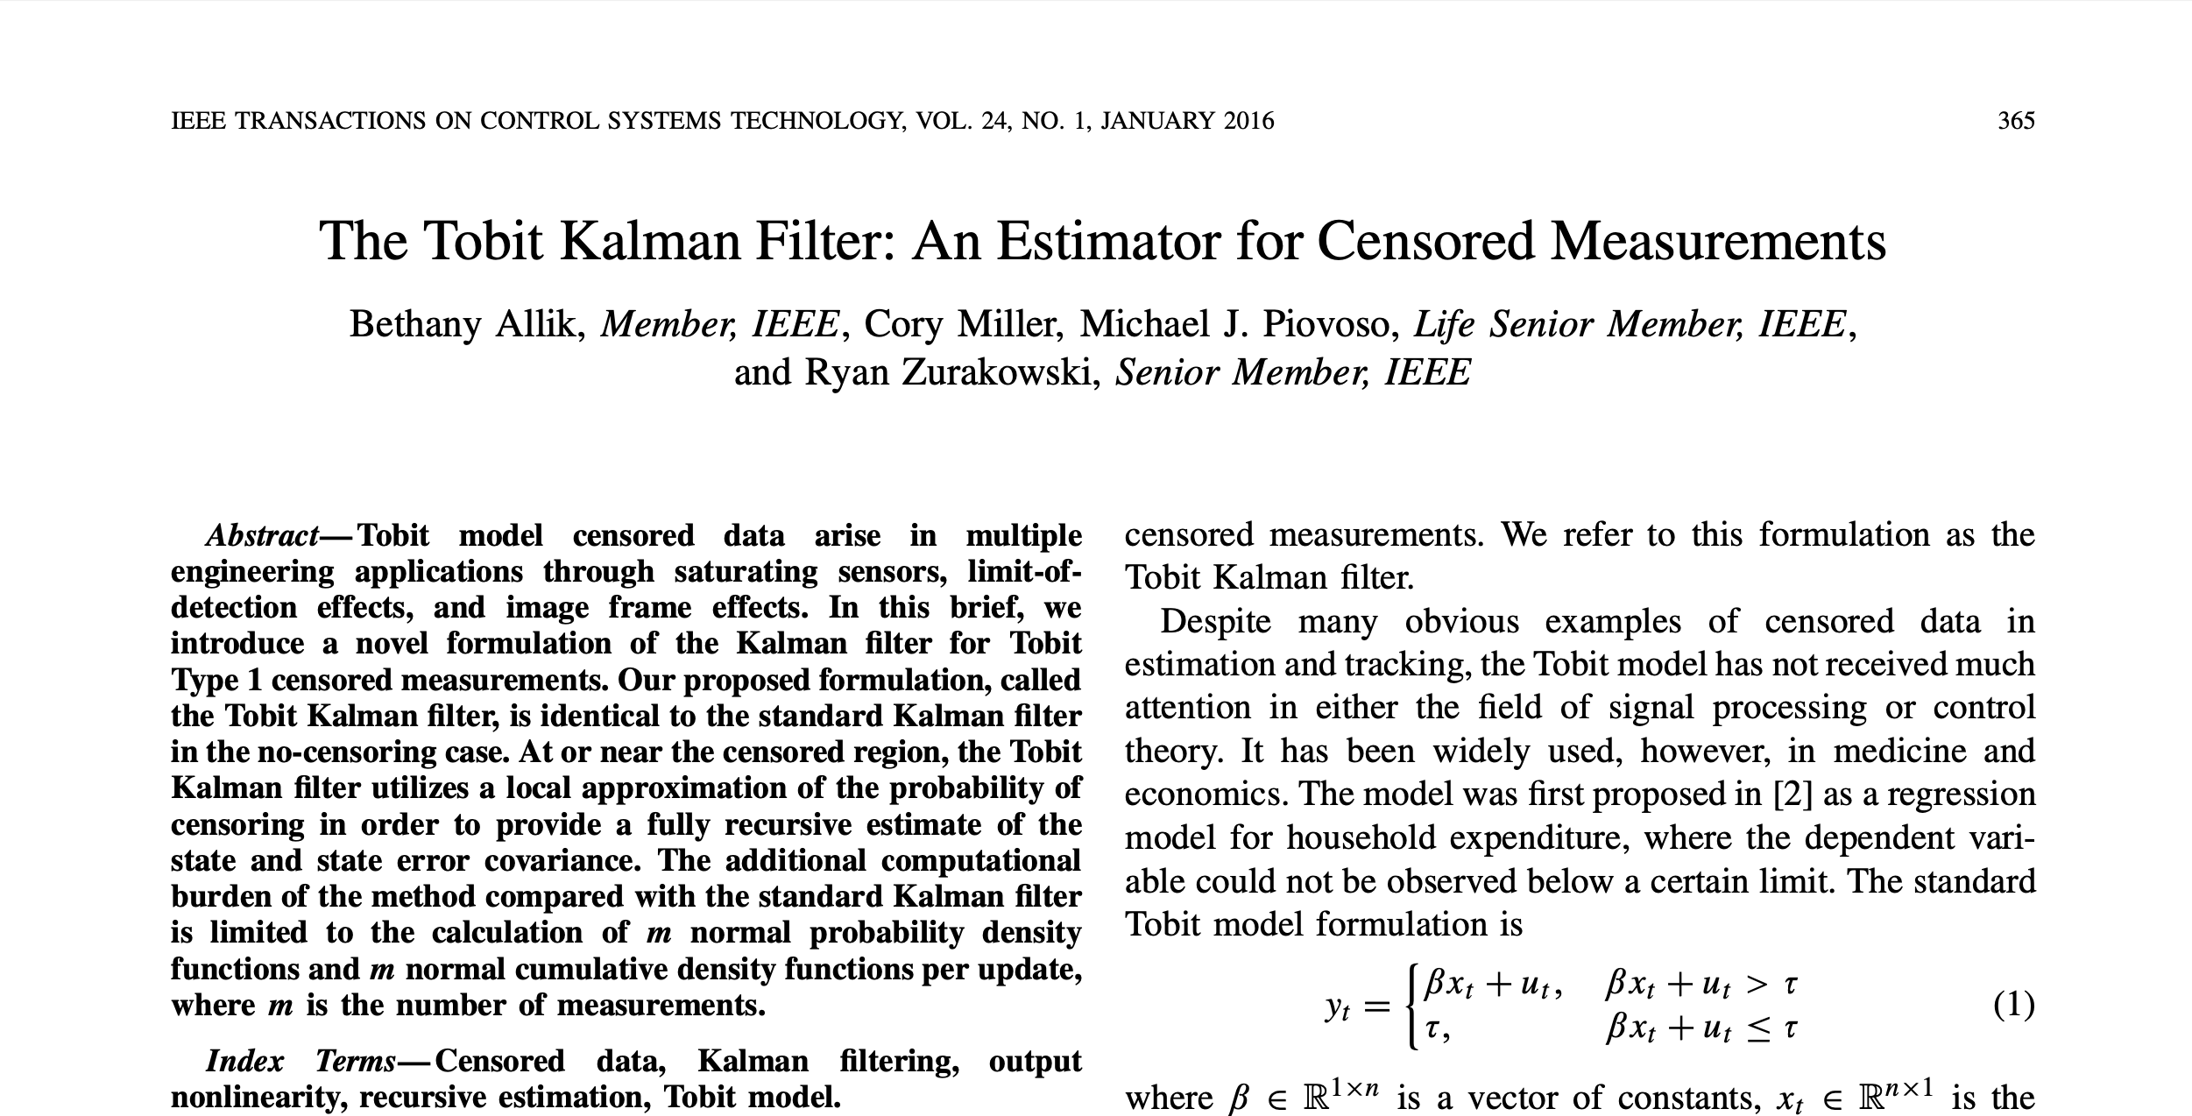
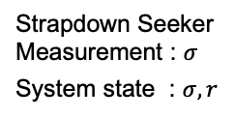
2
지난 연구 요약
자율 지능 시스템 연구실
Strapdown Seeker
Measurement : $σ$
System state : $σ, r$
[2]
[TKF]
[2] Y. Lee, S. Lee, Y. Kim, Y. Han, J. Park and G. -H. Kim, "Capture Region of Tactical Missile Equipped With Semi-Active Laser Seeker Using Tobit Kalman Filter," in IEEE Access, vol. 10, pp. 11714-11729, 2022, doi: 10.1109/ACCESS.2022.3145402.
[TKF] B. Allik, C. Miller, M. J. Piovoso and R. Zurakowski, "The Tobit Kalman Filter: An Estimator for Censored Measurements," in IEEE Transactions on Control Systems Technology, vol. 24, no. 1, pp. 365-371, Jan. 2016, doi: 10.1109/TCST.2015.2432155.

Slide 6
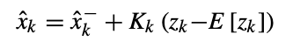
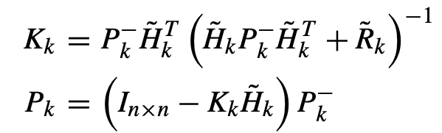
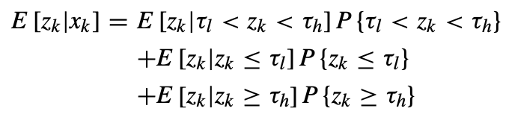
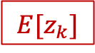
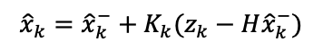
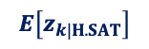
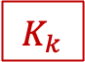
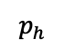
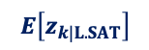
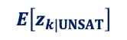
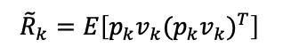
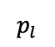
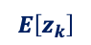
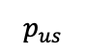
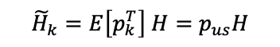

2
지난 연구 요약
자율 지능 시스템 연구실
Standard KF :
$${\hat{x}}_{k}={\hat{x}}_{k}^{−}+K_{k}(z_{k}−H{\hat{x}}_{k}^{−})$$
produces “biased estimate”.
Modified KF(TKF) :
is presented in a way that minimizes $P.$
Goal
Either SAT. or UNSAT.
Use Jacobian
$$K_{k}$$
$$E[z_{k}]$$
$$E\left[z_{k}\right]$$
$$E\left[z_{k|UNSAT}\right]$$
$$p_{us}$$
: Unsaturated Probability
$${\tilde{H}}_{k}=E\left[p_{k}^{T}\right] H=p_{us}H$$
: Low-saturated Probability
$$E\left[z_{k|L.SAT}\right]$$
$$p_{l}$$
$${\tilde{R}}_{k}=E\left[p_{k}v_{k}(p_{k}v_{k})^{T}\right]$$
: High-saturated Probability
$$E\left[z_{k|H.SAT}\right]$$
$$p_{h}$$

Slide 7
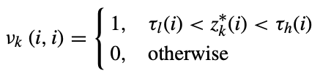
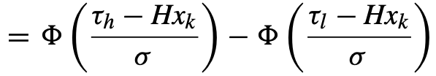
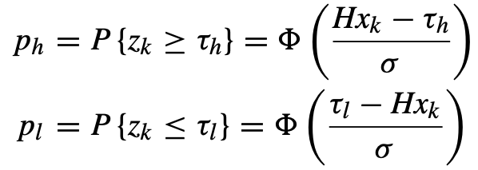
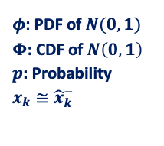
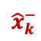
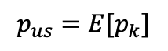
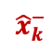
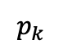
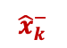
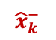
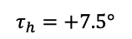
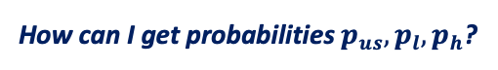
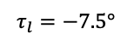
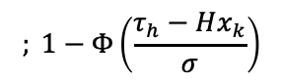
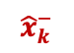
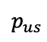
2
지난 연구 요약
자율 지능 시스템 연구실
How can I get probabilities $p_{us}, p_{l}, p_{h}$?
$φ$: PDF of $N(0,1)$
$Φ$: CDF of $N\left(0,1\right)$
$p$: Probability
$x_{k}≅{\hat{x}}_{k}^{−}$
Let new random variable $p_{k}$ follow Bernoulli Distribution.
: Unsaturated : Saturated
$$p_{k}$$
$$p_{us}=E[p_{k}]$$
Measured
$${\hat{x}}_{k}^{−}$$
$${\hat{x}}_{k}^{−}$$
$$τ_{h}=+7.5°$$
$$p_{us}$$
$${\hat{x}}_{k}^{−}$$
$${\hat{x}}_{k}^{−}$$
Actual
$$; 1−Φ\left(\frac{τ_{h}−Hx_{k}}{σ}\right)$$
$${\hat{x}}_{k}^{−}$$
$$τ_{l}=−7.5°$$
Assumption : We do not know the true state$(x_{k})$, thus, we assume the state prediction$({\hat{x}}_{k}^{−})$ provides a reasonably accurate estimate of the probability of censoring.
→ Probabilities are acquired.
Next step: Expected values of the measurements

Slide 8
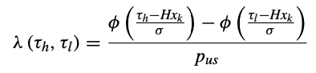
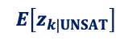
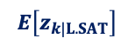
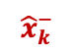
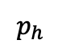
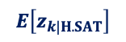
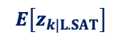
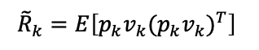
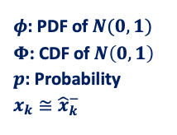
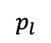





2
지난 연구 요약
자율 지능 시스템 연구실
How can I get expected values?
$φ$: PDF of $N(0,1)$
$Φ$: CDF of $N\left(0,1\right)$
$p$: Probability
$$x_{k}≅{\hat{x}}_{k}^{−}$$
$${\hat{x}}_{k}^{−}$$
where
$$E\left[z_{k|UNSAT}\right]$$
Inverse Mill’s Ratio
→ Plays the role of preventing expectation to be “Biased”.
$$E\left[z_{k|L.SAT}\right]$$
$$E\left[z_{k|H.SAT}\right]$$
→ Expected values of the measurement are acquired.
< Wrap-up >
$$E\left[z_{k|UNSAT}\right]$$
$$p_{us}$$
$$E\left[z_{k|L.SAT}\right]$$
$$p_{l}$$
$$E\left[z_{k|H.SAT}\right]$$
$$p_{h}$$
$${\hat{x}}_{k}^{−}$$
$${\tilde{H}}_{k}=E\left[p_{k}^{T}\right] H=p_{us}H$$
$${\tilde{R}}_{k}=E\left[p_{k}v_{k}(p_{k}v_{k})^{T}\right]$$
Refer to [TKF].

Slide 9











2
지난 연구 요약
자율 지능 시스템 연구실
[ Simulation Cases ]
Guidance Law: Impact Angle Control Composite Guidance(IACCG)
Case (1): Does TKF act as EKF(or standard KF) if measurements are far from the censoring region?
$$σ_{d}=7.5°, γ_{d}=−45°, λ_{switch}=38.75°, \left(τ_{l}, τ_{h}\right)=(−45°, +45°)$$
Case (2): Paper[2] Case
$$σ_{d}=7.5°, γ_{d}=−45°, λ_{switch}=−41.25°, \left(τ_{l}, τ_{h}\right)=(−7.5°, +7.5°)$$
(i) TKF
(ii) EKF with saturated measurements input
(iii) EKF without saturated measurements input(Vacant input: estimate only with prediction)
$σ_{d}$ : Desired look angle
$$r_{0}=7000\left[m\right] \\ λ_{0}=−27° \\ σ_{0}=5° \\ γ_{M_{0}}=−22° \\ V_{M}=200\left[m/s\right] \\ γ_{d}=−45° \\ N=3 \\ K=300$$
M
$$γ_{M_{0}}$$
$$σ_{0}$$
$$\vec{V_{M}}$$
$$r_{0}$$
SAT
$$H{\hat{x}}_{k}^{−})$$
$$λ_{0}$$
T(Stationary)
0
$$H{\hat{x}}_{k}^{−})$$

Slide 10

2
지난 연구 요약
자율 지능 시스템 연구실
[ Simulation Cases ]
Guidance Law: Impact Angle Control Composite Guidance(IACCG)
Case (3): Hard case ) $σ_{d}=σ_{sat}\left(τ_{l}, τ_{h}\right)=(−10°, +10°)$
$$σ_{d}=10°, γ_{d}=−45°, λ_{switch}=38.75°, \left(τ_{l}, τ_{h}\right)=(−10°, +10°)$$
(i) TKF
(ii) EKF with saturated measurements input
Case (4): Extreme Case ) $σ_{d}>σ_{sat}$
$$σ_{d}=7.8°, γ_{d}=−45°, λ_{switch}=−41.25°, \left(τ_{l}, τ_{h}\right)=(−7.5°, +7.5°)$$
(i) TKF
(ii) EKF with saturated measurements input
$σ_{d}$ : Desired look angle
$$r_{0}=7000\left[m\right] \\ λ_{0}=−27° \\ σ_{0}=5° \\ γ_{M_{0}}=−22° \\ V_{M}=200\left[m/s\right] \\ γ_{d}=−45° \\ N=3 \\ K=300$$
SAT
$$H{\hat{x}}_{k}^{−})$$
M
$$γ_{M_{0}}$$
$$σ_{0}$$
$$\vec{V_{M}}$$
$$r_{0}$$
$$λ_{0}$$
T(Stationary)
SAT
$$H{\hat{x}}_{k}^{−})$$

Slide 11






2
지난 연구 요약
자율 지능 시스템 연구실
Case (2) – (i) [TKF] & (ii) [EKF w/ SAT.Meas. Input $(z_{k}=z_{k|SAT})$]
$σ_{d}$ : Desired look angle
$$σ_{d}=7.5°, γ_{d}=−45°, λ_{switch}=−41.25°, \left(τ_{l}, τ_{h}\right)=(−7.5°, +7.5°)$$
Distance(Error) about $0.3°$
6.5
13.6
8
20.5
Fig. Look angle trajectory (i) [TKF]: $(\hat{σ}, σ_{true}, σ_{meas})$
Fig. Look angle trajectory (ii) [EKF w/ SAT.Meas.]: $(\hat{σ}, σ_{true}, σ_{meas})$

Slide 12




2
지난 연구 요약
자율 지능 시스템 연구실
Case (2) – (iii) [EKF w/o SAT.Meas. Input $({\hat{x}}_{k}={\hat{x}}_{k}^{−} +0)$]
$σ_{d}$ : Desired look angle
$$σ_{d}=7.5°, γ_{d}=−45°, λ_{switch}=−41.25°, \left(τ_{l}, τ_{h}\right)=(−7.5°, +7.5°)$$
M$(t_{o})$
Target
M$(t_{f})$
Fig. M&T Trajectory
Fig. Look angle trajectory(EKF w/o SAT.Meas.): $(\hat{σ}, σ_{true}, σ_{meas})$
Interception fails.

Slide 13







2
지난 연구 요약
자율 지능 시스템 연구실
Case (4) –Extreme case ) (i) TKF & (ii) EKF w/ SAT.Meas. Input )
$$σ_{d}=7.8°, γ_{d}=−45°, λ_{switch}=−41.25°, \left(τ_{l}, τ_{h}\right)=(−7.5°, +7.5°)$$
$σ_{true}$ values are slightly(0.1$°$) below $σ_{d}$.
Distance about $0.25°$
$ε_{σ}$ diverges.
Fig. Look angle trajectory (i) [TKF]: $(\hat{σ}, σ_{true}, σ_{meas})$
Fig. Look angle trajectory (ii) [EKF w/ SAT.Meas.]: $(\hat{σ}, σ_{true}, σ_{meas})$

Slide 14





2
지난 연구 요약
자율 지능 시스템 연구실
$σ_{d}$ is being maintained.
→ Saturated region lies all over the simulation.
$σ_{d}$ is being maintained.
→ Saturated region lies all over the simulation.
Fig. Look angle trajectory [TKF]Paper case: $σ_{d}=σ_{sat}$
Fig. Look angle trajectory [TKF]Extreme case: $σ_{d}>σ_{sat}$
$σ_{d}$-maintaining guidance laws(e.g. IACCG) are NOT able to control the saturated region.
→ Look for the other guidance laws which reach $σ_{d}$ ONCE(or at least decrease).

Slide 15

3
연구내용
자율 지능 시스템 연구실
[IACGBOM]
[IACGBOM] H. -G. Kim, J. -Y. Lee and H. J. Kim, "Look Angle Constrained Impact Angle Control Guidance Law for Homing Missiles With Bearings-Only Measurements," in IEEE Transactions on Aerospace and Electronic Systems, vol. 54, no. 6, pp. 3096-3107, Dec. 2018, doi: 10.1109/TAES.2018.2843600.

Slide 16












3
연구내용
자율 지능 시스템 연구실
[IACGBOM Brief Review] : Only focused for implementation!
<User chosen parameters>
<Error Variables>
: $e_{1}→0 as λ→γ_{d}(t→t_{f})$
: $e_{2}→0 as σ_{M}→0 (t→t_{f})$
<Surface Variable>
where
where
and its magnitude is bounded as
where
<Guidance Law>
Set as 0.01
In order to satisfy $\dot{S}$ being 0, $a_{M}$ becomes
where $sgn\left(aS\right)=tanh\left(aS\right)=2\left(\frac{1}{1+e^{−2aS}}−\frac{1}{2}\right), a=10$

Slide 17


3
연구내용
자율 지능 시스템 연구실
[IACGBOM Brief Review] : Only focused for implementation!
<User chosen parameters>
<Simulation Setting>
Initial M&T geometry
$k_{1}$ plays the role of $σ_{d}.$
User chosen parameters

Slide 18







3
연구내용
자율 지능 시스템 연구실
[IACGBOM Brief Review] : Only focused for implementation!
<Results Comparison>
Fig. [IACGBOM] Flight trajectories with $σ_{M}^{max}=45°$
Fig. Flight trajectory with $=γ_{d}=−60°$
Fig. Flight trajectory with $=γ_{d}=−120°$
Look into the $∇ \& O$ results.

Slide 19













3
연구내용
자율 지능 시스템 연구실
[IACGBOM Brief Review] : Only focused for implementation!
<Results Comparison>
$$+45°$$
$$+45°$$
$$0°$$
$$0°$$
$$−60°$$
$$−120°$$
Fig. [IACGBOM] $γ_{M} \& σ_{M }$with $σ_{M}^{max}=45°$
Fig. $γ_{M}, σ_{M }\& λ$with $=γ_{d}=−60°$
Fig. $γ_{M}, σ_{M }\& λ$with $=γ_{d}=−120°$
Look into the $∇ \& O$ results.

Slide 20











3
연구내용
자율 지능 시스템 연구실
[IACGBOM Brief Review] : Only focused for implementation!
<Results Comparison>
: $e_{1}→0 as λ→γ_{d}(t→t_{f})$
: $e_{2}→0 as σ_{M}→0 (t→t_{f})$
$$+45°$$
$$+45°$$
$$0°$$
$$0°$$
Fig. [IACGBOM] $e_{1} \& e_{2 }$with $σ_{M}^{max}=45°$
Fig. $e_{1} \& e_{2 }$with $=γ_{d}=−60°$
Fig. $e_{1} \& e_{2 }$with $=γ_{d}=−120°$
Look into the $∇ \& O$ results.
[IACGBOM] is well validated. Utilize into the TKF!

Slide 21






3
연구내용
자율 지능 시스템 연구실
Case (2) Revisited – (i) [IACGBOM w/ TKF]
$σ_{d}$ : Desired look angle
$(3σ)$: 3 $×$ (Error Covariance)
$$k_{1}=σ_{d}=7.5°, γ_{d}=−45°, \left(τ_{l}, τ_{h}\right)=(−7.5°, +7.5°)$$
$(3σ)$ value is from $P(1,1)$
Fig. Look angle error trajectory(TKF)
Fig. Look angle trajectory(TKF): $(\hat{σ}, σ_{true}, σ_{meas})$

Slide 22

3
연구내용
자율 지능 시스템 연구실
Case (2) Revisited – (i) [IACGBOM w/ TKF]
$σ_{d}$ : Desired look angle
$(3σ)$: 3 $×$ (Error Covariance)
$$k_{1}=σ_{d}=7.5°, γ_{d}=−45°, \left(τ_{l}, τ_{h}\right)=(−7.5°, +7.5°)$$
Though $k_{1}$ is set $7.5°, max\left(σ_{true}\right)=7.1°$
→ Does not reach $σ_{d}$.
Fig. Look angle trajectory(TKF): $(\hat{σ}, σ_{true}, σ_{meas})$

Slide 23


3
연구내용
자율 지능 시스템 연구실
Case (2) Revisited – (i) [IACGBOM w/ TKF]
$$k_{1}=σ_{d}=7.5°, γ_{d}=−45°, \left(τ_{l}, τ_{h}\right)=(−7.5°, +7.5°)$$
< Estimated values-dealt IACGBOM Variables >
All the variables do NOT converge to 0.
→ Okay. It may be caused by estimation errors.
< Sliding Surface Variable >
< Error Variables >
What if dealt-with true values?

Slide 24



3
연구내용
자율 지능 시스템 연구실
Case (2) Revisited – (i) [IACGBOM w/ TKF]
$$k_{1}=σ_{d}=7.5°, γ_{d}=−45°, \left(τ_{l}, τ_{h}\right)=(−7.5°, +7.5°)$$
< Estimated values-dealt IACGBOM Variables >
All the variables do NOT converge to 0.
→ Okay. It may be caused by estimation errors.
< Sliding Surface Variable >
< Error Variables >
What if dealt-with true values?
< True values-dealt IACGBOM Variables >
All the variables do NOT converge to 0 neither.
< Sliding Surface Variable >
< Error Variables >
→ Adjust $k_{1}$ manually(empirically).

Slide 25





3
연구내용
자율 지능 시스템 연구실
Extreme Case) TKF) $σ_{d}>σ_{sat}$
$σ_{d}$ : Desired look angle
$(3σ)$: 3 $×$ (Error Covariance)
$$k_{1}=10.80°,σ_{d}=10°,γ_{d}=−45°, \left(τ_{l}, τ_{h}\right)=(−7.5°, +7.5°)$$
$$max\left(σ_{true}\right)=10.00°$$
$$t_{sat}=24.82sec (1.38\sim 26.2)$$
Fig. Look angle error trajectory(TKF)
Fig. Look angle trajectory(TKF): $(\hat{σ}, σ_{true}, σ_{meas})$

Slide 26






3
연구내용
자율 지능 시스템 연구실
Extreme Case) TKF) $σ_{d}>σ_{sat}$
$σ_{d}$ : Desired look angle
$(3σ)$: 3 $×$ (Error Covariance)
$$k_{1}=10.80°,σ_{d}=10°,γ_{d}=−45°, \left(τ_{l}, τ_{h}\right)=(−7.5°, +7.5°)$$
The moment $p_{us}$ increases($p_{h}$ decreases) again is when $P\left(1,1\right)$ decreases again.
Fig. TKF Probabilities: $p_{l}, p_{h}, p_{us}$
Fig. Expectations : $E\left[z_{k}\right], E\left[z_{k|UNSAT}\right],E\left[z_{k|L.SAT}\right],E\left[z_{k|H.SAT}\right]$
Fig. Look angle error trajectory(TKF)

Slide 27







3
연구내용
자율 지능 시스템 연구실
Extreme Case) TKF) $k_{1}>σ_{sat}$
$(3σ)$: 3 $×$ (Error Covariance)
$$k_{1}=60°,γ_{d}=−45°, \left(τ_{l}, τ_{h}\right)=(−7.5°, +7.5°)$$
$$max\left(σ_{true}\right)=53.69°$$
53.69
Slightly over than $(3σ)$ bound.
7.5
Fig. Look angle error trajectory(TKF)
Fig. Look angle trajectory(TKF): $(\hat{σ}, σ_{true}, σ_{meas})$

Slide 28





3
연구내용
자율 지능 시스템 연구실
Extreme Case) TKF) $k_{1}>σ_{sat}$
$(3σ)$: 3 $×$ (Error Covariance)
$$k_{1}=150°,γ_{d}=−45°, \left(τ_{l}, τ_{h}\right)=(−7.5°, +7.5°)$$
$$max\left(σ_{true}\right)=124.96°$$
+124.96
Way too much over than 3-$σ$ bound.
→ Unstable engagement!
Saturated at both regions.
+7.5
-7.5
Fig. Look angle error trajectory(TKF)
Fig. Look angle trajectory(TKF): $(\hat{σ}, σ_{true}, σ_{meas})$

Slide 29



3
연구내용
자율 지능 시스템 연구실
Extreme Case) TKF) $k_{1}>σ_{sat}$
$(3σ)$: 3 $×$ (Error Covariance)
$$k_{1}=150°,γ_{d}=−45°, \left(τ_{l}, τ_{h}\right)=(−7.5°, +7.5°)$$
$$max\left(σ_{true}\right)=124.96°$$
+124.96
$$M(t_{0})$$
Way too much over than 3-$σ$ bound.
→ Unstable engagement!
Fig. M&T Trajectory
Saturated at both regions.
$$M(t_{f})$$
+7.5
-7.5
Fig. Look angle error trajectory(TKF)
Fig. Look angle trajectory(TKF): $(\hat{σ}, σ_{true}, σ_{meas})$

Slide 30
3
연구내용
자율 지능 시스템 연구실
Representative Case) $k_{1}=10.80°,γ_{d}=−45°, \left(τ_{l}, τ_{h}\right)=(−7.5°, +7.5°)$
Fig. Look angle trajectory(TKF): $(\hat{σ}, σ_{true}, σ_{meas})$
Fig. Look angle error trajectory(TKF)
What would be the most significant parameters that determine(manage) the stability of missile trajectory?
Saturated Area? Saturated Time? User-chosen desired look angle? 3$σ \& ε_{σ}$?
→ Perform the parametric study !

Slide 31












3
연구내용
자율 지능 시스템 연구실
[ Parametric Study Cases ]
$k_{1}$ plays the role of $σ_{d}$ | $γ_{d}$: Desired impact angle
[ Saturated Area Definition ]
 | $$k_{1}$$ | $$γ_{d}$$
Case 1 | $$[+9°, +170°]$$ $0.1°$ step | Fixed$(−45°)$
Case 2 | Fixed$(+9°)$ | $$[−15°, −120°]$$ $0.1°$ step
[Absolute values]
$$A_{true}=A_{h|true}+A_{l|true}$$
$$A_{est}=A_{h|est}+A_{l|est}$$
$$+7.5°$$
$$−7.5°$$
[ Nomenclature ]
$sat(SAT)$: Saturated
$A$: Saturated area ; Positive value
$T$: Saturated time
$true$ : (Based on) True values
$est$ : (Based on) Estimated values
e.g. $A_{true}$: Saturated region area under true look angles
$T_{est}$: Saturated time under estimated look angles
[ Engagement Initial Conditions]
M
$$γ_{M_{0}}$$
$$r_{0}=7000\left[m\right] \\ λ_{0}=−27° \\ σ_{0}=5° \\ γ_{M_{0}}=−22° \\ V_{M}=200\left[m/s\right]$$
$$σ_{0}$$
$$\vec{V_{M}}$$
$$r_{0}$$
$$λ_{0}$$
T(Stationary)

Slide 32











3
연구내용
자율 지능 시스템 연구실
[ Case 1 - $σ_{max|true}$ depending on $k_{1}$ ]
 | $$k_{1}$$ | $$γ_{d}$$
Case 1 | $$[+9°, +170°]$$ $0.1°$ step | Fixed$(−45°)$
$$σ_{max|true}=139.034°$$
Nonlinear
Nonlinear
$$ε_{f}=30.966°$$
$$σ_{max|true}=8.386°$$
Deviation$(ε)=k_{1}−σ_{max|true}$
$$ε_{0}=0.614°$$
$$k_{1}=9°$$
$$k_{1}=170°$$
Fig. $σ_{max|true}$ depending on $k_{1}$
No significant consideration found.

Slide 33







3
연구내용
자율 지능 시스템 연구실
[ Case 1 - $T_{est} \& T_{true}$ depending on $k_{1}$ ]
 | $$k_{1}$$ | $$γ_{d}$$
Case 1 | $$[+9°, +170°]$$ $0.1°$ step | Fixed$(−45°)$
$T_{max|true}=25.33[sec]$
$T_{max|est}=25.15[sec]$
$T_{min|true}=14.39[sec]$
$T_{min|est}=14.37[sec]$
$$k_{1}=12.2°$$
$$k_{1}=122.7°$$
Fig. $T_{est} \& T_{true}$ depending on $k_{1}$

Slide 34






3
연구내용
자율 지능 시스템 연구실
[ Case 1 - $T_{est} \& T_{true}$ depending on $k_{1}$ ]
 | $$k_{1}$$ | $$γ_{d}$$
Case 1 | $$[+9°, +170°]$$ $0.1°$ step | Fixed$(−45°)$
$T_{max|true}=25.33[sec]$
$T_{max|est}=25.15[sec]$
Fig. Look angle: $(\hat{σ}, σ_{true}, σ_{meas})$
Fig. Look angle error
Fig. Look angle: $(\hat{σ}, σ_{true}, σ_{meas})$
Fig. Look angle error
$T_{min|true}=14.39[sec]$
$T_{min|est}=14.37[sec]$
$$k_{1}=12.2°$$
$$k_{1}=122.7°$$
Fig. $T_{est} \& T_{true}$ depending on $k_{1}$
Small $T_{est} \& T_{true}$ does NOT mean any chance of engagement being stable.

Slide 35










3
연구내용
자율 지능 시스템 연구실
[ Case 1 - $A_{est} \& A_{true}$ depending on $k_{1}$ ]
 | $$k_{1}$$ | $$γ_{d}$$
Case 1 | $$[+9°, +170°]$$ $0.1°$ step | Fixed$(−45°)$
$A_{max|true}=1110.10$
$A_{max|est}=1102.83$
Inflection point may tell us something.
Inflection point is somewhere in this range.
$A_{min|true}=14.007$
$A_{min|est}=14.136$
$$k_{1}=60°$$
$$k_{1}=100°$$
$$k_{1}=9°$$
$$k_{1}=170°$$
Fig. $A_{est} \& A_{true}$ depending on $k_{1}$
Though $T_{est} \& T_{true}$ decrease, $A_{est} \& A_{true}$ increase.

Slide 36























3
연구내용
자율 지능 시스템 연구실
[ Case 1 - $A_{est} \& A_{true}$ depending on $k_{1}$ ]
 | $$k_{1}$$ | $$γ_{d}$$
Case 1 | $$[+9°, +170°]$$ $0.1°$ step | Fixed$(−45°)$
20%
30%
(2/10) goes beyond the 3$σ$ bound.
(3/10) goes beyond the 3$σ$ bound.
60$°$
90$°$
70$°$
80$°$
100$°$
Fig. $A_{est} \& A_{true}$ depending on $k_{1}$
Fig. Look angle error: $k_{1}=60°$
Fig. Look angle error: $k_{1}=70°$
60$°$
50%
87%
95%
(7/14) goes beyond the 3$σ$ bound.
(13/15) goes beyond the 3$σ$ bound.
(19/20) goes beyond the 3$σ$ bound.
Fig. Look angle error: $k_{1}=80°$
Fig. Look angle error: $k_{1}=90°$
Fig. Look angle error: $k_{1}=100°$
We may tell there’s a “tendency” that near the inflection point $ε_{σ}$ “may” go beyond the 3$σ$ bound.

Slide 37











3
연구내용
자율 지능 시스템 연구실
[ Case 2 - $σ_{max|true}$ depending on $γ_{d}$ ]
 | $$k_{1}$$ | $$γ_{d}$$
Case 2 | Fixed$(+9°)$ | $$[−15°, −120°]$$ $0.1°$ step
Both $σ_{M} \& 3σ$ bound starts diverging.
→ Considered as a result of being lack of $σ_{d}\left(k_{1}\right).$
FAILURE due to
not enough $σ_{d}\left(k_{1}\right)$.
Starts chattering
$$σ_{max|true}=9.881°$$
$$σ_{max|true}=5.001°$$
$τ_{h}$ SAT.
UNSAT.
$$−62.2°$$
$$−15°$$
Fig. $σ_{max|true}$ depending on $γ_{d}$
No significant consideration found.

Slide 38










3
연구내용
자율 지능 시스템 연구실
[ Case 2 - $T_{est} \&{ T}_{true}$ depending on $γ_{d}$ ]
 | $$k_{1}$$ | $$γ_{d}$$
Case 2 | Fixed$(+9°)$ | $$[−15°, −120°]$$ $0.1°$ step
$$T_{est}=33.78$$
$$T_{true}=33.84$$
$$T_{est}=34.06$$
$$T_{true}=34.07$$
Very slightly diverging
FAILURE due to
not enough $σ_{d}\left(k_{1}\right)$.
$τ_{h}$ SAT.
UNSAT.
$$−17°$$
$$−36.8°$$
$$−62.2°$$
Fig. $T_{est} \&{ T}_{true}$depending on $γ_{d}$
No significant consideration found.

Slide 39











3
연구내용
자율 지능 시스템 연구실
[ Case 2 -$A_{est} \& A_{true}$ depending on $γ_{d}$ ]
 | $$k_{1}$$ | $$γ_{d}$$
Case 2 | Fixed$(+9°)$ | $$[−15°, −120°]$$ $0.1°$ step
Very slightly diverging
$A_{true}$ starts to deviate off from $A_{est}$.
FAILURE due to
not enough $σ_{d}\left(k_{1}\right)$.
$A_{true}$ starts chattering harder.
UNSAT.
$τ_{h}$ SAT.
$$−53.8°$$
$$−62.2°$$
$$−17°$$
$$−36.8°$$
Fig.$A_{est} \& A_{true}$ depending on $γ_{d}$
No significant consideration found.

Slide 40




3
연구내용
자율 지능 시스템 연구실
[ Method(Idea) 1]
[ Method(Idea) 2]
$${(3σ)}_{threshold}$$
$${(3σ)}_{threshold}$$
$$+7.5°$$
$$−7.5°$$
Fig. Look angle trajectory(TKF): $(\hat{σ}, σ_{true}, σ_{meas})$
Fig. Look angle error trajectory(TKF)
If $A\left(k_{1}, γ_{d}\right)≥A_{threshold}$,
command relock-on.
If $\left(3σ\right)≥{(3σ)}_{threshold}$,
command relock-on.

Slide 41










3
연구내용
자율 지능 시스템 연구실
[ Parametric Study Cases ]
$k_{1}$ plays the role of $σ_{d}.$
 | $$k_{1}$$ | $$γ_{d}$$
Case 1 | $$[+9°, +170°]$$ $0.1°$ step | Fixed$(−45°)$
Case 2 | Fixed$(+9°)$ | $$[−15°, −120°]$$ $0.1°$ step
Consider “feasible” $k_{1}$ range.
→ $k_{1}∈[+9°, +60°]$
Case 3: $k_{1}$ VS. $γ_{d}$ VS. $A_{est}$ - 3D surface plot
What are the achievable $γ_{d}$ ranges?
[ Engagement Initial Conditions]
As error variables$(e_{1}, e_{2})$ & surface variable$(S)$
do NOT converge to 0 if simulated as Air-to-surface,
and also…
in order to compare results with Pure IACGBOM,
Simulate as [IACGBOM] Case(Surface-to-surface).
M
$$γ_{M_{0}}$$
$$r_{0}=7000\left[m\right] \\ λ_{0}=−27° \\ σ_{0}=5° \\ γ_{M_{0}}=−22° \\ V_{M}=200\left[m/s\right]$$
$$σ_{0}$$
$$\vec{V_{M}}$$
$$r_{0}$$
$$λ_{0}$$
T(Stationary)

Slide 42






3
연구내용
자율 지능 시스템 연구실
[Simulation Setting – Pure IACGBOM Case]
<Initial Geometry>
$(x_{M_{0}},y_{M_{0}})=(0,0)$m
$(x_{T_{0}},y_{T_{0}})=(10000,0)$m
$σ_{M_{0}}=15°$
$V_{M}=250$m/s
$\left|a_{max}\right|=100m/s^{2}$
<User-chosen Parameters>
$R_{f}=0.01$m
$φ_{1}=0.15$
$k_{2}=10°$
$dt=0.01$
$\left(τ_{l}, τ_{h}\right)=±20°$
<Guidance Command>
$\tanh{(aS)}$
$$a=0.01$$
<Interception Criterion>
$ε_{R}=3$m
$ε_{λ}=2.5°$

Slide 43






3
연구내용
자율 지능 시스템 연구실
[ Parametric Study Case ]
$k_{1}$ plays the role of $σ_{d}.$
[ Saturated Area Definition ]
 | $$k_{1}$$ | $$γ_{d}$$
Case 3 | $[+9°, +60°]$ $1°$ step | $[−15°, −150°]$ $1°$ step
$$+20°$$
[Absolute values]
$$A_{true}=A_{h|true}+A_{l|true}$$
$$A_{est}=A_{h|est}+A_{l|est}$$
[ Nomenclature ]
$sat(SAT)$: Saturated
$A$: Saturated area ; Positive value
$T$: Saturated time
$true$ : (Based on) True values
$est$ : (Based on) Estimated values
e.g. $A_{true}$: Saturated region area under true look angles
$T_{est}$: Saturated time under estimated look angles

Slide 44






3
연구내용
자율 지능 시스템 연구실
[ Parametric Study Case 3 ]
$k_{1}$ plays the role of $σ_{d}.$
$A_{est}$: Saturated area
$γ_{d}$ : Desired impact angle
$k_{1}$ : Desired look angle
Some outliers have been re-simulated then edited.
$$A_{est}$$
-15
$$k_{1}$$
$$γ_{d}$$
9

Slide 45

3
연구내용
자율 지능 시스템 연구실
[ Parametric Study Case 3 ]
$k_{1}$ plays the role of $σ_{d}.$
$A_{est}$: Saturated area
$γ_{d}$ : Desired impact angle
$k_{1}$ : Desired look angle
Inflection Points?
$$A_{est}$$
Projection
-15
$$k_{1}$$
$$γ_{d}$$
9

Slide 46













3
연구내용
자율 지능 시스템 연구실
[ Parametric Study Case 3 ]
$A_{est}$: Saturated area
$γ_{d}$ : Desired impact angle
$k_{1}$ : Desired look angle
$$γ_{d}=−150°$$
$$γ_{d}=−135°$$
$$γ_{d}=−120°$$
$$γ_{d}=−105°$$
$$γ_{d}=−90°$$
$$γ_{d}=−75°$$
$$γ_{d}=−60°$$
$$A_{est}$$
$$γ_{d}=−45°$$
$$γ_{d}=−30°$$
$$γ_{d}=−15°$$
9
$$k_{1}$$
Inflection points are visually NOT inspected…

Slide 47
3
연구내용
자율 지능 시스템 연구실
[ Parametric Study Case 3 ]
$A_{est}$: Saturated area
$γ_{d}$ : Desired impact angle
$k_{1}$ : Desired look angle
$$γ_{d}=−150°$$
$$γ_{d}=−135°$$
$$γ_{d}=−120°$$
$$γ_{d}=−105°$$
$$γ_{d}=−90°$$
$$γ_{d}=−75°$$
$$γ_{d}=−60°$$
$$A_{est}$$
$$γ_{d}=−45°$$
$$γ_{d}=−30°$$
$$γ_{d}=−15°$$
9
$$k_{1}$$
Inflection points are visually NOT inspected…
However, there are points where $A_{est}$ bounces off a bit : $ε_{σ}>(3σ)$ for the entire saturated time.

Slide 48






3
연구내용
자율 지능 시스템 연구실
[ Parametric Study Case 3 ]
$A_{est}$: Saturated area
$γ_{d}$ : Desired impact angle
$k_{1}$ : Desired look angle
$$γ_{d}=−150°$$
$$γ_{d}=−135°$$
$$γ_{d}=−120°$$
$$γ_{d}=−105°$$
$$γ_{d}=−90°$$
$$γ_{d}=−75°$$
$$γ_{d}=−60°$$
Fig. Look angle error: $k_{1}=51°$
Fig. Look angle error: $k_{1}=52°$
$$γ_{d}=−45°$$
$$k_{1}=52°$$
$$γ_{d}=−30°$$
$$k_{1}=51°$$
$$γ_{d}=−15°$$
9
$$k_{1}$$
Inflection points are visually NOT inspected…
However, there are points where $A_{est}$ bounces off a bit : $ε_{σ}>(3σ)$ for the entire saturated time.

Slide 49

3
연구내용
자율 지능 시스템 연구실
[ Parametric Study Case 3 ]
$k_{1}$ plays the role of $σ_{d}.$
$A_{est}$: Saturated area
$γ_{d}$ : Desired impact angle
$k_{1}$ : Desired look angle
Feasible(Achievable) $γ_{d}$ range?
$$A_{est}$$
-15
$$k_{1}$$
$$γ_{d}$$
9

Slide 50







3
연구내용
자율 지능 시스템 연구실
[ Parametric Study Case 3 ]
$A_{est}$: Saturated area
$γ_{d}$ : Desired impact angle
$k_{1}$ : Desired look angle
Look angle error $(ε_{σ}>\left(3σ\right))$ is NOT considered.
ONLY $ε_{R}(3m) \& ε_{λ}(2.5°)$ are considered.
; DIA: Desired Impact Angle
Too low $k_{1}$ : $ε_{R} \& ε_{λ}$diverge at the Final Phase.
Too high $k_{1}$ : Not enough time to relock-on.
Also, $ε_{σ}≫\left(3σ\right)$
$$γ_{d|max}$$
$$k_{1}$$
Figure does NOT mean IACGBOM w/ TKF is not performing well.
Utilization of $k_{1}$ is different btw IACGBOM w/ TKF & Pure IACGBOM.

Slide 51












3
연구내용
자율 지능 시스템 연구실
[ Parametric Study Case 3 ]
$A_{est}$: Saturated area
$γ_{d}$ : Desired impact angle
$k_{1}$ : Desired look angle
Too high $k_{1}$
Feasible $k_{1}$ range
$$A_{est}$$
Too low $k_{1}$
$$k_{1}$$
$$γ_{d}$$
FAILURE
SUCCESS
FAILURE
$$k_{1}↓$$
$$k_{1}↑$$
Too low $k_{1}$ : $ε_{R} \& ε_{λ}$diverge.
However, $ε_{σ}<\left(3σ\right)$
Feasible $k_{1}$ range
Too high $k_{1}$ : $ε_{σ}≫\left(3σ\right)$

Slide 52








4
향후 연구방향
자율 지능 시스템 연구실
< $γ_{d}=−120°$ Case >
If $(ε_{σ}>\left(3σ\right))$ considered,
$(ε_{σ}<\left(3σ\right))$ Boundary
Feasible $k_{1}$ range
Feasible $k_{1}$ range
Look angle error $(ε_{σ}>\left(3σ\right))$ is NOT considered.
ONLY $ε_{R}(3m) \& ε_{λ}(2.5°)$ are considered.
Both look angle error $(ε_{σ}>\left(3σ\right))$ and
$ε_{R}(3m) \& ε_{λ}(2.5°)$ are considered.
Will there be any way to increase feasibility of $k_{1}$?
→ Adaptive $k_{1}$
→ $γ_{d|max}$ Profile & $(ε_{σ}<\left(3σ\right))$ Profile will change!

Slide 53
5
문의사항
자율 지능 시스템 연구실
.
Any Question ?

Slide 54
자율 지능 시스템 연구실
감사합니다

